Slide 1
National Security(s) of Pakistan

Slide 2
Defining National Security(s)
National security “National security is the requirement to maintain the survival of the state through the use of economic power, diplomacy, power projection and political power”. (Paul D. Williams, 2008)
According to United Nations Office for the Coordination of Humanitarian Affairs (OCHA) human security elements have acquired a wider dimension. OCHA’s expanded definition of security calls for a wide range of security areas:
1. Economic: creation of employment and measures against poverty.
2. Food: measures against hunger and famine.
3. Health: measures against disease, unsafe food, malnutrition and lack of access to basic health care.

Slide 3
Defining National Security(s)
4. Environmental: measures against environmental degradation, resource depletion, natural disasters and pollution.
5. Personal: measures against physical violence, crime, terrorism, domestic violence and child labor.
6. Community: measures against inter-ethnic, religious and other identity tensions.
7. Political: measures against political repression and human rights abuses. (http://hdr.undp.org/en/media/HS_Handbook_2009.pdf)
Political Security: refers to protecting the sovereignty of the government and political system and the safety of society from unlawful internal threats and external threats or pressures. It involves both national and homeland security and law enforcement.

Slide 4
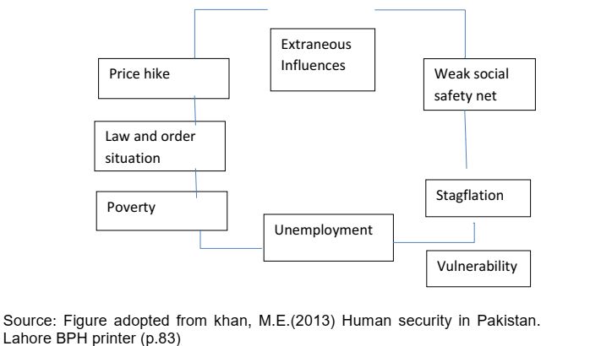
Economic Security
Economic Security: involves not only protecting the capacity of the economy to provide for the people, but also the degree to which the government and the people are free to control their economic and financial decisions. It also entails the ability to protect a nation’s wealth and economic freedom from outside threats and coercion.

Slide 5
Economic Security
For a better understanding of economic issues in Pakistan it is summarized into three areas. 1. Policy Problems 2. Management lapses 3. Domestic environment
Fiscal Deficit.
Low export growth and excess of imports.
Low domestic savings
Burden of External and internal debt. (40.12 Trillion Pakistan Rupees)
Mismanagement in Collection of Taxes.
General Poverty and low living standards.
Unemployment and brain drain.
Political Instability and Law and Order situation.

Slide 6
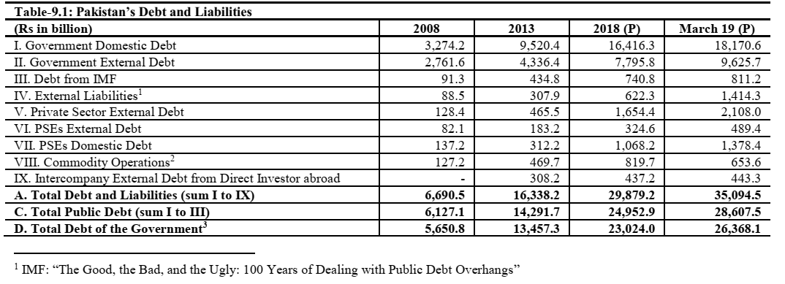
Pakistan’s Debt and Liabilities

Slide 7
Energy and Natural Resources Security
Energy and natural resources security: is most often defined as the degree to which a nation or people have access to such energy resources as oil, gas, water, and minerals. It would be more accurate to describe it as access freely determined by the market without interference from other nations or political or military entities for non-market, political purposes.
Between years 2013-18, adding a cumulative capacity of 12,230 MW.
National Transmission and Dispatch Company (NTDC) has prepared and submitted Indicative Generation Capacity Expansion Plan (IGCEP) 2018-40 to National Electric Power Regulatory Authority (NEPRA)
In term of energy-mix, Pakistan reliance on oil reached 43.5 percent in FY1998 and FY2001. For the FY2018, oil reliance has reduced to 31.2 percent. Similarly, hydro had a 13.1 percent share in FY1998, which is standing at 7.7 percent in 2017-18.

Slide 8
Energy and Natural Resources Security
Pakistan dependence on natural gas reached an all-time high of 50.4 percent in FY2006 in the overall energy mix. For the FY2018, reliance on gas has reduced to 34.6 percent.
FY2018 has recorded a high of 12.7 percent coal consumption in the energy mix.
The share of renewables was recorded to be 0.3 percent in the year FY2015, which was steadily increased to 1.1 percent in FY2018. The share of nuclear on the other side has steadily increased to 2.7 percent in FY2018 compared to 0.2 percent in FY1997.
During July - March FY2019, installed capacity of electricity reached 34,282 MW, which was 33,433 MW in corresponding period last year, thus, posting a growth of 2.5 percent.

Slide 9
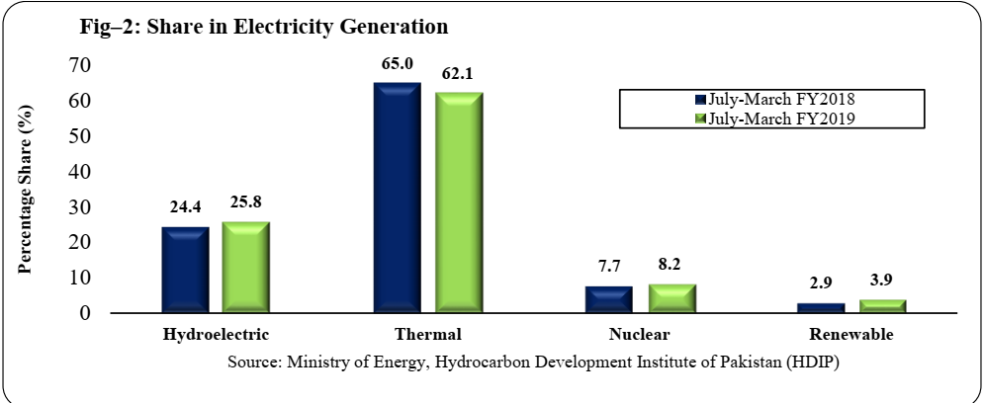
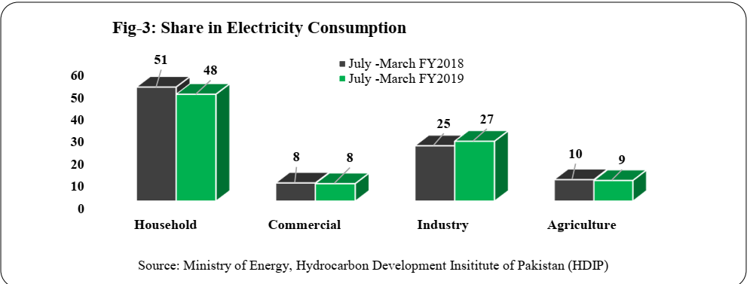

Slide 10
Food Security
“Food security exists when all people, at all times, have physical and economic access to sufficient, safe and nutritious food that meets their dietary needs and food preferences for an active and healthy life”. (World Food Summit, 1996)
This widely accepted definition points to the following dimensions of food security:
Food availability: The availability of sufficient quantities of food of appropriate quality, supplied through domestic production or imports (including food aid).
Food access: Access by individuals to adequate resources (entitlements) for acquiring appropriate foods for a nutritious diet. Entitlements are defined as the set of all commodity bundles over which a person can establish command given the legal, political, economic and social arrangements of the community in which they live (including traditional rights such as access to common resources).

Slide 11
Food Security
Utilization: Utilization of food through adequate diet, clean water, sanitation and health care to reach a state of nutritional well-being where all physiological needs are met. This brings out the importance of non-food inputs in food security.
Stability: To be food secure, a population, household or individual must have access to adequate food at all times. They should not risk losing access to food as a consequence of sudden shocks (e.g. an economic or climatic crisis) or cyclical events (e.g. seasonal food insecurity). The concept of stability can therefore refer to both the availability and access dimensions of food security.

Slide 12
Food Security
Agriculture contributes 18.5 percent to country’s Gross Domestic Product (GDP) and provides 38.5 percent employment to national labor force.
The “Productivity Enhancement of Wheat, Rice & Sugarcane” developed under Prime Minister’s Agriculture Emergency Program. Cost of Wheat project is Rs.19,301 million, Rice project is Rs.11,433 million and Sugarcane project is Rs.3,912 million over a period of 05 years.
Project “National Oilseeds Enhancement Program” developed under Prime Minister’s Agriculture Emergency Program. Project cost is Rs.10,176 million over a period of 05 years.
Project “Conserving water through lining of Watercourses” developed under Prime Minister’s Agriculture Emergency Program for lining up to 50% of total length of 73,078 watercourses (reconstruction & new) inclusive of 13,875 Water Storage Tanks. This also includes Laser Land Levelers, on 50% cost sharing basis government’s share to be capped at Rs.250,000 per beneficiary. The total project cost is Rs.179,705 million over a period of 05 years.

Slide 13
Food Security
The crops sector experienced a negative growth (-4.43 percent against the target of 3.6 percent) on the back of decline in growth of important crops by (-6.55) percent. Sugarcane production declined by (-19.4) percent to 67.174 million tons, Cotton (-17.5 percent) to 9.861 million bales and Rice (-3.3 percent) to 7.202 million tones while production of Maize crop increased by 6.9 percent to 6.309 million tones and Wheat growth was marginally higher (by 0.5 percent) to reach 25.195 million tones.
Livestock having share of 60.54 percent in agriculture and 11.22 percent in GDP, maintained the growth at 4.0 percent against the target of 3.8 percent. The Fishing sector having share of 2.10 percent in agriculture value addition (and 0.39 percent in GDP), grew by 0.79 percent, while Forestry sector having share of 2.10 percent in agriculture (and 0.39 percent in GDP) grew by 6.47 percent due to increase in timber production in Khyber Pakhtunkhwa (by 26.7 percent to 36.1 thousand cubic meters).

Slide 14
Water Security of Pakistan
UN-Water, the United Nations’ inter-agency coordination mechanism for all water-related issues, says water security should be defined as: “The capacity of a population to safeguard sustainable access to adequate quantities of and acceptable quality water for sustaining livelihoods, human well-being, and socio-economic development, for ensuring protection against water-borne pollution and water-related disasters, and for preserving ecosystems in a climate of peace and political stability.”
Indus water Treaty of 1960 Pakistan and India divided rivers (Beas, Ravi and Sutlej Went to India and Indus, Chenab and Jhelum went to Pakistan).
The access to improved drinking water sources (piped, hand pump, motorized pump and closed well) is 89 percentage, available when needed (24 hours available at premises) is 77.5 percent, basic service is 53 percent (basic services but not free from contamination) contamination is 36 percent. The lowest figure of all three that is free from contamination is 36 percent, which is the baseline figure of safely managed water in Pakistan in 2018.
By 2030, experts expect that Pakistan a semiarid nation to decline from being water stressed to water scarce.

Slide 15
Water Security of Pakistan
The United Nations (UN) currently estimates an annual per capita availability of 1,090 cubic meters.
Stresses are considered high if the TRWR (Total Renewable water resource) value is above 25 percent. Pakistan’s water pressure amounts to a staggering 74 percent.
Rainfall averages around 494 mm a year. The estimated long-term basin-wide surface water availability is approximately 194 to 209 million acre-feet (MAF), of which 142 MAF is extracted in Pakistan.20 Average renewable water availability is about 154 MAF, of which 45 MAF is from groundwater.
An average of about 138 MAF flows annually into Pakistan in the Western Rivers. Th e vast majority of surface water extractions are made from the Western Rivers, where flows are measured by “rim stations”—at Kalabagh for the Indus, Mangla for the Jhelum, and Marala for the Chenab. More than 80 percent of the annual flow of the Western Rivers occurs in the three kharif (summer) months.
Current water withdrawals in Pakistan total about 142 MAF. Approximately 71 percent of withdrawals are from surface water and 29 percent from subsurface groundwater.
However, the Indus’ massive irrigation system has a storage capacity of only 121 MAF per year, or a thirty-day supply.25 This capacity is extremely low given that India can store for 120 to 220 days, Egypt up to 700 days, and the United States for 900 days.

Slide 16
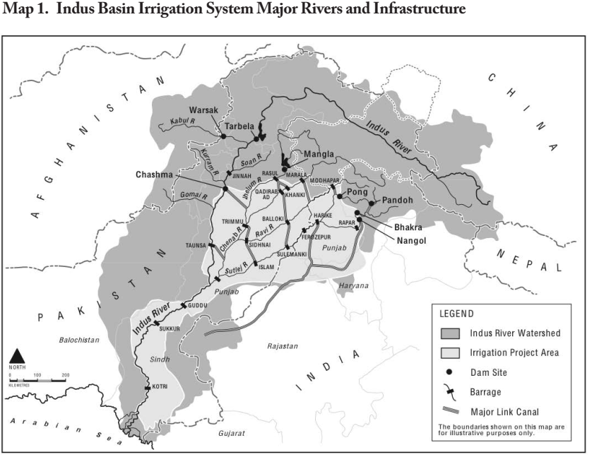
Water Security of Pakistan

Slide 17
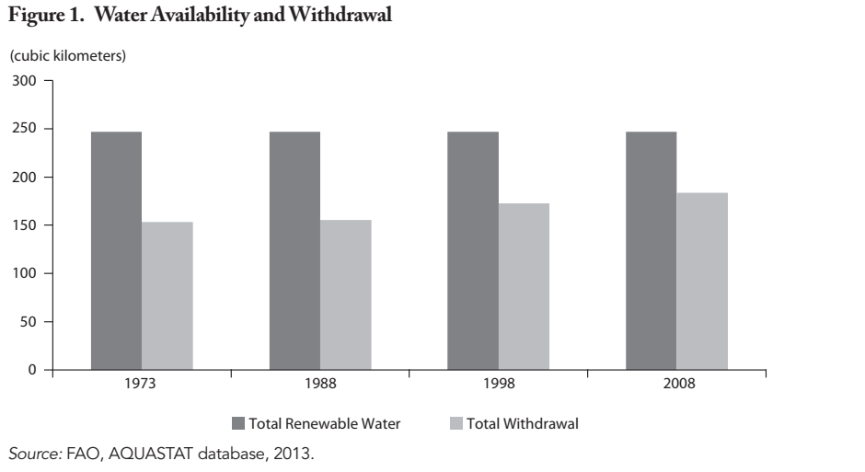
Water Security of Pakistan
That is, demand is projected to rise to 274 MAF by 2025. Th is said, total water availability by 2025 is not likely to change from the current 191 MAF. Th is gap of about 81 MAF is almost two-thirds of the entire Indus River system’s current annual average flow.

